Slide 1
Integrated Practice Management Systems
Medical Informatics even semester - 2017

Slide 2
Learning Objectives
After reading this chapter the reader should be able to:
Document the workflow in a medical office that utilizes a practice management (PM)
System integrated with an electronic health record system
Compare the functionality of a standalone PM system with fully integrated PM software as part of a robust EHR system
Identify the features of an integrated practice management system
List the most common integrated PM software packages currently available
Identify the key advantages and obstacles in converting from paper records and a standalone PM system to an integrated PM with EHR system
Discuss emerging trends in practice management

Slide 3
Definition
Medical practice management software (PMS) is a category of software that deals with the day-to-day operations of a medical practice. Such software frequently allows users to
capture patient demographics,
schedule appointments,
maintain lists of insurance payers,
perform billing tasks, and
generate reports.

Slide 4
Capture patient demographics
A PM system is designed to capture all of the data from a patient encounter necessary to obtain reimbursement for the services provided. This data is then used to:
Generate claims to seek reimbursement from healthcare payers
Apply payments and denials
Generate patient statements for any balance that is the patient’s responsibility
Generate business correspondence
Build databases for practice and referring physicians, payers, patient demographics and patient encounter transactions (i.e., date, diagnosis codes, procedure codes, amount charged, amount paid, date paid, billing messages, place and type of service codes etc.)
Additionally, a PM system provides routine and ad hoc reports so that an administrator can analyze the trends for a given practice and implement performance improvement strategies based on the findings.

Slide 5
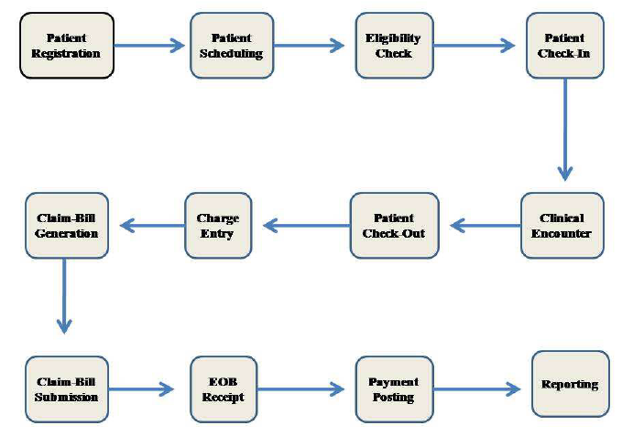
Clinical and Administrative Workflow in a Medical Office
demonstrates typical outpatient office workflow.

Slide 6
Examples Clinical and Administrative Workflow in a Medical Office
Patient Registration.
Patient Encounter.
Clinical Aspects of Patient Encounter.
After the Patient Encounter.
Telephone calls in a Medical Office.
Note: Read the topic from the PDF provided at the website.

Slide 7
Patient Registration
This step includes obtaining demographic information, financially responsibility, scheduled for an appointment, etc

Slide 8
Patient Encounter
The patient checks in for the scheduled visit. If already established with the practice the receptionist simply verifies/updates the patient information

Slide 9
Clinical Aspects of Patient Encounter.
The patient is generally first seen by a nurse, to have vitals taken, collect blood and urine samples, if needed, and update the patient’s subjective history

Slide 10
After the Patient Encounter
The patient is discharged after a receptionist collects any money due and schedules any follow-up visits.

Slide 11
Telephone calls in a Medical Office
Calls to the practice may be for various reasons from cancelling an appointment to asking if the doctor can see a patient who does not have an appointment.

Slide 12
Practice Management Systems and EHRs
When the administrators of a medical practice commit to the conversion of paper-based or hybrid records to an electronic health record system, they should strongly consider converting their existing practice management system to one that is integrated with the EHR they chose.
In March of 2008, the Medical Society of New York reported on the experience of a solo, internal medicine practice in identifying, purchasing, implementing and maintaining an EHR with a PM system. Some of the highlights from this article include:

Slide 13
Chose in-office server over application service provider (ASP) because it was more affordable since the practice already had old computers that could be used as workstations
Chose to pay a monthly subscription fee to use the EHR/PM software because it was less expensive than purchasing software and hardware required. Lease agreement was approximately $400 per month for software and off-site HIT support.
HIT vendor provided most of the on-site technical support during the first three months
Chose the EHR from same vendor as PM because, “to run an efficient office, the two systems should be totally compatible and ideally share the same database.”

Slide 14
Key success
Many practices report that part of their overall success with implementing an EHR with a PM system is due to the increased efficiency and accuracy of the billing process when the systems are integrated.
One alternative to discontinuing an existing PM system – especially one that works very well and that everyone in the office who uses it is comfortable with, is to find a reputable EHR vendor that offers interface capabilities with your existing PM system vendor.
For example, Eclipsys (formerly MediNotes), has a list of PM systems with which their EHR interfaces.
One potential setback is anytime a vendor upgrades its software, the interfaces have to be tested and both vendors may need to get involved.

Slide 15
Some of the highlights from implementing EHR with a PM system.
Chose in-office server over application service provider (ASP) because it was more affordable since the practice already had old computers that could be used as workstations and they did not already have business-grade broadband Internet service provider necessary for an ASP arrangement
Chose to pay a monthly subscription fee to use the EHR/PM software because it was less expensive than purchasing software and hardware required. Lease agreement was approximately $400 per month for software and off-site HIT support.

Slide 16
Some of …
Chose the EHR from same vendor as PM because, “to run an efficient office, the two systems should be totally compatible and ideally share the same database.”

Slide 17
PM systems criteria
The PM systems criteria most important to most of the healthcare practitioners included:
perform the same functions as a paper record only better;
affordability;
navigability for all users between both the EHR and the PM systems;
adaptability -the records and templates for information were easily modified and customized as patient information and practice needs changed;
track record of vendor;
ease of data entry;
tight security.

Slide 18
Practice Management System Examples
There are more than 200 practice management systems on the market with a variety of PM features to include integration with an EHR and the availability as both a client server model and/or an ASP model.

Slide 19
For prospective purchasers of PM systems and/or EHR systems several resources are worth mentioning:
Capterra is a web site that includes a search engine with filters for operating systems (platform), number of users, PM features, inclusion with EHRs, location (example USA) and annual revenue. Over 200 products are included with hyperlinks to the individual web sites, demos and tours 12
EHRScope is a search engine for EHRs but includes the ability to filter the search for EHRs that include PM systems, as well as differentiate between systems are are web-based or client-server based. Without filtering, 342 EHRs are included 13
“Selecting a Practice Management System” is a monograph by the American College of Physicians. Members can access this resource that focuses how to go about selecting a PM system, in terms of the steps that are necessary prior to purchase 14
“Medical Practice Management Buyer’s Guide” is a May 2008 web-based resource that includes pricing and tips before purchase.
The Online Consultant is a fee based generator of “requests for proposal” (RFP). In the case of PM systems they generate detailed questions about price and functional requirements.
Once the RFP is complete they offer the ability to graph and create comparison reports between vendors. Charge is $695 for PM RFP 16

Slide 20
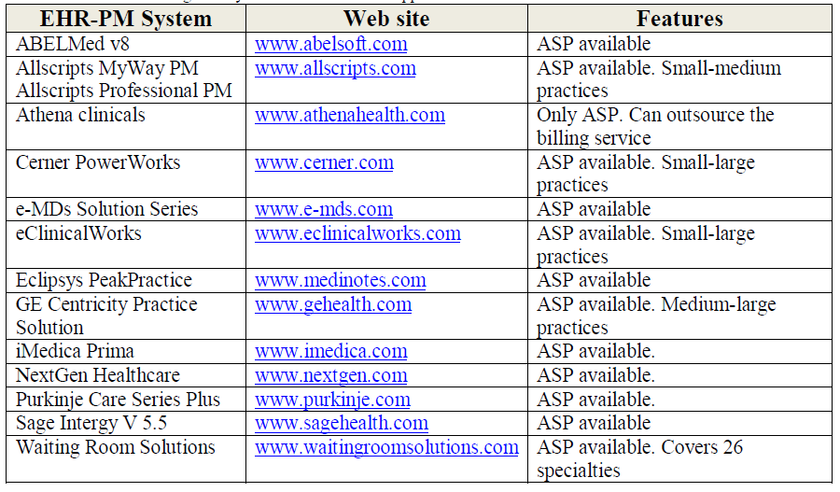

Slide 21
Key Points
Many medical practices are struggling with implementation of EHRs and how to determine the return on investment (ROI) for a new integrated PM system
As reimbursement methodologies become increasingly more complex and tied to quality measures, it is of utmost importance to ensure a medical office has the tools to obtain full payment to which the practice is legally and ethically entitled by collecting all of the appropriate data that justifies medical necessity and compliance with quality guidelines
Practitioners not only have to provide high quality and safe patient care but they must do so as efficiently and effectively as to remain competitive

Slide 22
Conclusion
There are dozens of options for ambulatory care practices to investigate before converting to a robust electronic health record system that is fully integrated with, or interfaced with, a comprehensive practice management system.
The chapter in this book on electronic health records discusses the steps a practice can take to identify the best overall electronic health record and practice management system based on factors such as size and type of practice, degree to which each physician supports the transition, information technology preferences (servers, technical support, purchase versus lease etc.), priority of various features, projected return on investment (ROI) and other considerations. The practice management piece fits in nicely with the overall HER selection, implementation, training and maintenance process but should be included from the start rather than starting the selection and implementation piece after the EHR system is already in place.
Although not every practice that implemented an EHR/PM system agrees, the combination of functionality between the clinical aspects and the business aspects of medical practice is considered the ideal future direction by many physicians and administrators who have had their combined systems long enough to enjoy an excellent return on their investment, improved efficiency, improved quality of care documentation and reimbursement.

